Slide 1
All-Pairs Testing taught by: Dan Tripp
All-Pairs Testing
taught by: Dan Tripp

Slide 2
The Problem (slide 1 of 3)
The Problem (slide 1 of 2)
Testing a certain imaginary web page template
Parameter | Values | Number of tests (cumulative)
Browser | Chrome, Firefox, Edge | 3
Layout | Desktop, Mobile | 3*2 = 6
Operating System | Windows, macOS, Ubuntu | 3*2*3 = 18
High Contrast Mode | On, Off | 3*2*3*2 = 36
Viewport width | 1280, 640, 320 | 3*2*3*2*3 = 108
Number of columns | 1, 2, 4 | 3*2*3*2*3*3 = 324
Blog CMS | Drupal, Wordpress, Joomla | 3*2*3*2*3*3*3 = 972
Blog – number of posts | 0, 1, 2, 10 | 3*2*3*2*3*3*3*4 = 3888

Slide 3
The Problem (slide 2 of 2)

Slide 4
The Crucial Observation
The Crucial Observation (slide 1 of 2)
Num params | Cumulative percent of bugs
1 | 29%
2 | 76%
3 | 95%
4 | 97%
5 | 99%
6 | 100%
Source: “An investigation of the applicability of design of experiments to software testing”, Kuhn et al., January 2003, IEEE Xplore. Table 1.

Slide 5
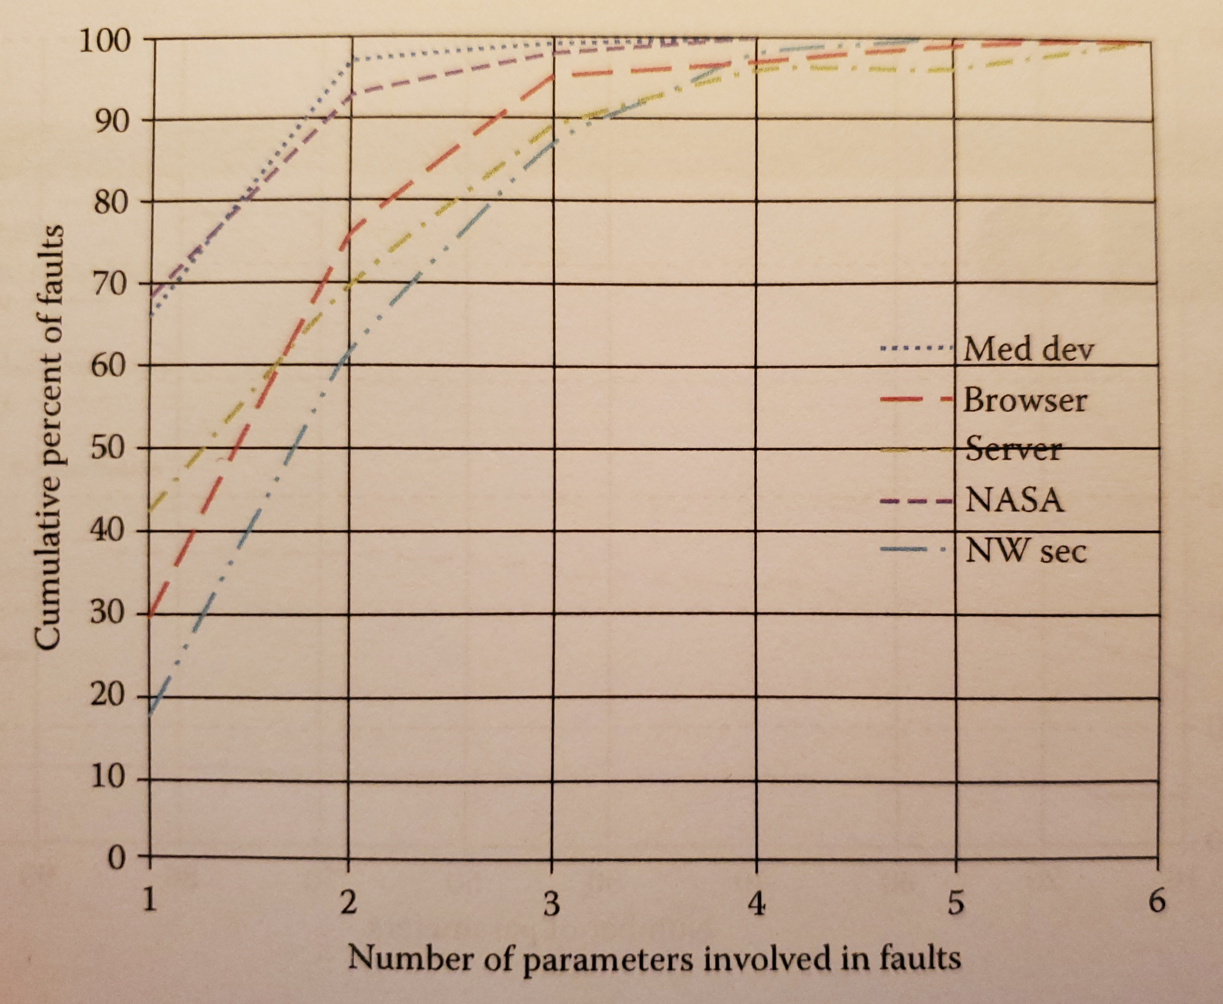
The Crucial Observation
The Crucial Observation (slide 2 of 2)
 | Cumulative percent of faults
Num params | Med dev | Browser | Server | NASA | NW sec
1 | 65% | 29% | 41% | 68% | 18%
2 | 96% | 76% | 70% | 94% | 62%
3 | 98% | 95% | 89% | 98% | 86%
4 | 100% | 97% | 96% | 100% | 96%
5 | 100% | 99% | 96% | 100% | 100%
6 | 100% | 100% | 100% | 100% | 100%
Sources:
- Introduction to Combinatorial Testing, Kuhn et al., 2013, page 202.
- “An investigation of the applicability of design of experiments to software testing”, Kuhn et al., January 2003, IEEE Xplore. Table 1.

Slide 6
All-pairs – tool-generated (slide 1 of 2)
All-pairs – tool-generated (slide 1 of 2)
Revisiting our “web page template” example:
Parameters:
BROWSER: firefox, chrome, edge
LAYOUT: desktop, mobile
PALETTE: forced_palette, normal_colors
OS: windows, macos, linux
VIEWPORT_WIDTH: 1280, 640, 320
NUM_COLUMNS: 1, 2, 4
BLOG_CMS: drupal, wordpress, joomla
BLOG_NUM_POSTS: 0, 1, 2, 10
Number of tests in the exhaustive test set: 3888
Number of tests in the all-pairs test set: 17
17/3888 = 0.4%

Slide 7
All-pairs – tool-generated (slide 2 of 2)
All-pairs – tool-generated (slide 2 of 2)
BROWSER: firefox, chrome, edge
LAYOUT: desktop, mobile
PALETTE: forced_palette, normal_colors
OS: windows, macos, linux
VIEWPORT_WIDTH: 1280, 640, 320
NUM_COLUMNS: 1, 2, 4
BLOG_CMS: drupal, wordpress, joomla
BLOG_NUM_POSTS: 0, 1, 2, 10
BROWSER LAYOUT PALETTE OS VIEWPORT_WIDTH NUM_COLUMNS BLOG_CMS BLOG_NUM_POSTS
chrome desktop forced_palette macos 320 4 joomla 1
chrome desktop normal_colors macos 1280 2 drupal 0
chrome desktop normal_colors windows 640 1 joomla 2
chrome mobile forced_palette linux 1280 2 joomla 1
chrome mobile forced_palette windows 320 2 wordpress 2
chrome mobile normal_colors windows 640 4 joomla 10
edge desktop forced_palette macos 1280 2 wordpress 10
edge desktop forced_palette windows 1280 4 drupal 2
edge mobile forced_palette windows 320 1 joomla 0
edge mobile normal_colors linux 640 4 wordpress 0
edge mobile normal_colors macos 640 2 joomla 1
firefox desktop forced_palette linux 640 4 wordpress 1
firefox desktop normal_colors windows 640 1 drupal 1
firefox mobile forced_palette macos 1280 1 wordpress 2
firefox mobile normal_colors linux 320 1 drupal 10
firefox mobile normal_colors linux 1280 2 joomla 2
firefox mobile normal_colors macos 320 1 drupal 0

Slide 8
PICT in action
1) Go here: https://pairwise.yuuniworks.com/
2) Paste this:
BROWSER: firefox, chrome, edge
LAYOUT: desktop, mobile
PALETTE: forced_palette, normal_colors
OS: windows, macos, linux
VIEWPORT_WIDTH: 1280, 640, 320
NUM_COLUMNS: 1, 2, 4
BLOG_CMS: drupal, wordpress, joomla
BLOG_NUM_POSTS: 0, 1, 2, 10
3) Click “Generate”

Slide 9
All-pairs – manually generated
All-pairs – manually generated
Parameters:
BROWSER: firefox, chrome
LAYOUT: desktop, mobile
PALETTE: forced_palette, normal_colors
List of tests - exhaustive:
BROWSER LAYOUT PALETTE
test 1: chrome desktop forced_palette
test 2: chrome desktop normal_colors
test 3: chrome mobile forced_palette
test 4: chrome mobile normal_colors
test 5: firefox desktop forced_palette
test 6: firefox desktop normal_colors
test 7: firefox mobile forced_palette
test 8: firefox mobile normal_colors
List of tests - all pairs:
BROWSER LAYOUT PALETTE
test 2: chrome desktop normal_colors
test 3: chrome mobile forced_palette
test 5: firefox desktop forced_palette
test 8: firefox mobile normal_colors

Slide 10
Case Study: DOM event implementations in browsers
Case Study: DOM event implementations in browsers
"Four-way combinatorial testing found all DOM faults using 95% fewer tests than the original [exhaustive] test suite.“ - Introduction to Combinatorial Testing, Kuhn et al., 2013, section 2.1.3.
Events: Blur, Click, KeyDown, KeyUp, MouseDown, MouseUp, MouseWheel, and more - 35 events total.
Exhaustive testing: 36,626 tests.
Number of values per parameter: between 3 and 15.
t | Tests | Percent of Original
2 | 702 | 1.92
3 | 1342 | 3.67
4 | 1818 | 4.96
5 | 2742 | 7.49
6 | 4227 | 11.54

Slide 11
Case Study: Android app configuration file
Case Study: Android app configuration file
Parameter Name | Values | # Values
HARDKEYBOARDHIDDEN | NO, UNDEFINED, YES | 3
KEYBOARDHIDDEN | NO, UNDEFINED, YES | 3
KEYBOARD | 12KEY, NOKEYS, QWERTY, UNDEFINED | 4
NAVIGATIONHIDDEN | NO, UNDEFINED, YES | 3
NAVIGATION | DPAD, NONAV, TRACKBALL, UNDEFINED, WHEEL | 5
ORIENTATION | LANDSCAPE, PORTRAIT, SQUARE, UNDEFINED | 4
SCREENLAYOUT_LONG | MASK, NO, UNDEFINED, YES | 4
SCREENLAYOUT_SIZE | LARGE, MASK, NORMAL, SMALL, UNDEFINED | 5
TOUCHSCREEN | FINGER, NOTOUCH, STYLUS, UNDEFINED | 4
Exhaustive testing: 172,800 tests.
Combinatorial testing:
t | Tests | Percent of Exhaustive
2 | 29 | 0.02
3 | 137 | 0.08
4 | 625 | 0.4
5 | 2532 | 1.5
6 | 9168 | 5.3
Source: Introduction to Combinatorial Testing, Kuhn et al., 2013, section 3.2.

Slide 12
Increasing number of parameters (slide 1 of 2)
Increasing number of parameters (slide 1 of 2)
Number of parameters | Number of tests
1 | 2
2 | 4
3 | 6
4 | 6
5 | 6
6 | 6
7 | 6
8 | 6
9 | 6
10 | 8
Source: https://math.nist.gov/coveringarrays/ipof/tables/table.2.2.html

Slide 13
Increasing number of parameters (slide 2 of 2)
Increasing number of parameters (slide 2 of 2)
Number of parameters | Number of tests for v=2 | Number of tests for v=3 | Number of tests for v=4
1 | 2 | 3 | 4
2 | 4 | 9 | 16
3 | 6 | 10 | 17
4 | 6 | 12 | 20
5 | 6 | 13 | 22
6 | 6 | 15 | 24
7 | 6 | 15 | 27
8 | 6 | 15 | 27
9 | 6 | 17 | 29
10 | 8 | 19 | 29
Source: https://math.nist.gov/coveringarrays/ipof/ipof-results.html

Slide 14
Increasing number of values per parameter
Increasing number of values per parameter
Number of values per parameter | Number of tests for all pairs | Number of tests for all triplets | Number of tests for all quadruples
1 | 1 | 1 | 1
2 | 7 | 13 | 23
3 | 12 | 43 | 100
4 | 22 | 100 | 333
5 | 36 | 186 | 810
6 | 49 | 317 | 1695
7 | 66 | 497 | 3089
8 | 86 | 736 | 5252
9 | 108 | 1037 | 8385
10 | 130 | 1410 | 12743
Source: Dan Tripp

Slide 15
Infeasible combinations – the problem
Infeasible combinations – the problem
OS: android, windows, ios
BROWSER: safari, edge, firefox, samsung_internet
LAYOUT: desktop, mobile
OS BROWSER LAYOUT
android edge desktop
android firefox mobile
android safari mobile
android samsung_internet desktop
ios edge mobile
ios firefox mobile
ios safari desktop
ios samsung_internet desktop
windows edge desktop
windows firefox desktop
windows safari mobile
windows samsung_internet mobile

Slide 16
Infeasible combinations – the problem
Infeasible combinations – the problem
OS: android, windows, ios
BROWSER: safari, edge, firefox, samsung_internet
LAYOUT: desktop, mobile
OS BROWSER LAYOUT
android edge desktop
android firefox mobile
android safari mobile SKIP
android samsung_internet desktop
ios edge mobile
ios firefox mobile
ios safari desktop
ios samsung_internet desktop SKIP
windows edge desktop
windows firefox desktop
windows safari mobile SKIP
windows samsung_internet mobile SKIP

Slide 17
Infeasible combinations – the solution
Infeasible combinations – the solution
OS: android, windows, ios
BROWSER: safari, edge, firefox, samsung_internet
LAYOUT: desktop, mobile
# New:
if [BROWSER] = "samsung_internet" then [OS] = "android";
if [BROWSER] = "safari" then [OS] = "ios";
OS BROWSER LAYOUT
android edge desktop
android firefox desktop
android samsung_internet desktop
android samsung_internet mobile
ios edge mobile
ios firefox mobile
ios safari desktop
ios safari mobile
windows edge desktop
windows firefox mobile

Slide 18
Ineffectual combinations – the problem
Ineffectual combinations – the problem
NUM_SEARCH_RESULTS: 0, 1, 2, 999
BROWSER: firefox, chrome, safari
LAYOUT: desktop, mobile
PALETTE: forced_palette, normal_colors
NUM_SEARCH_RESULTS BROWSER LAYOUT PALETTE
0 chrome desktop forced_palette
0 firefox mobile forced_palette
0 safari desktop normal_colors
1 chrome mobile normal_colors
1 firefox desktop normal_colors
1 safari desktop forced_palette
2 chrome desktop forced_palette
2 firefox desktop normal_colors
2 safari mobile normal_colors
999 chrome mobile forced_palette
999 firefox desktop normal_colors
999 safari desktop forced_palette

Slide 19
Ineffectual combinations – the solution
Ineffectual combinations – the solution
NUM_SEARCH_RESULTS: ~0, 1, 2, 999
# ^^ New: the "~" before the "0"
BROWSER: firefox, chrome, safari
LAYOUT: desktop, mobile
PALETTE: forced_palette, normal_colors
NUM_SEARCH_RESULTS BROWSER LAYOUT PALETTE
~0 chrome desktop forced_palette
~0 firefox mobile forced_palette
~0 safari desktop normal_colors
1 chrome desktop normal_colors
1 firefox mobile normal_colors
1 safari mobile forced_palette
2 chrome mobile normal_colors
2 firefox mobile forced_palette
2 safari desktop forced_palette
999 chrome mobile forced_palette
999 firefox desktop forced_palette
999 safari desktop normal_colors

Slide 20
Follow-up
Follow-up
daniel.john.tripp@gmail.com / dtr@siteimprove.com
https://linkedin.com/in/dan-tripp
https://dan-tripp-siteimprove.github.io/accessu-2023-all-pairs-testing

